Slide 1
UML DIAGRAMS

Slide 2
UML DIAGRAMS
Object-oriented modeling in UML is done using UML diagrams.
UML provides nine different diagrams. All these diagrams are designed to visualize a system from different perspectives.
Designing of UML diagrams begin with requirements analysis phase and move towards design, development and implementation phases.
These diagrams contain UML building blocks and object relationships.
The UML diagrams are divided into the following 4 + 1 different views. The “”+1” view is the user’s view, which is a crosscutting view of all other views.

Slide 3
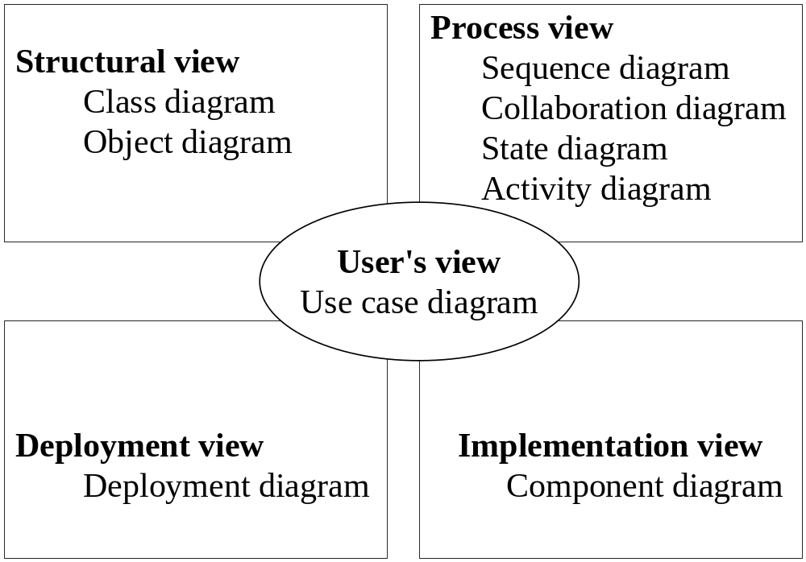
4+1 VIEW OF UML DIAGRAMS

Slide 4
4+1 VIEW OF UML DIAGRAMS
User’s view: It is also known as analysis view. It focuses on system functionalities, system services, and actors.
Structural view: This is also known as design view. It represents the structure of a system in terms of classes, interfaces, and their relationships.
Process view: This is also known as behavioral view. It defines the flow of the system.
Implementation view: This is also known as physical view. In this view, components are assembled together to make a complete physical system.
Deployment view: This is also known as environmental view. The components are identified for deployment as physical nodes in the system.

Slide 5
USE CASE DIAGRAM
“Use case” means what the different “uses” of a system are.
Use case depicts the functions that the system provides to the actors.
The use case diagram shows which actors interact with which use case.
It is primarily used to capture the user requirements. The user requirements are represented in an abstract manner without a description of their details.
The behavior of a system can be observed through objects and their relationships and interactions.
The use case diagram results into the use case model, which has actors, use cases, and the communication lines between them, along with the events that occur.
Use cases are also described with the use case scenarios.

Slide 6
USE CASE SCENARIO
The use case scenario is the textual representation of use cases and it covers all the following important aspects of the system:
System: This section provides the name of the system, along with the name of authors, date, and version of the system.
Use case name and use case number: Generally, a system has several use cases. Therefore, each use case should be numbered and it should have a well-defined name.
Participating actors: These are the persons or systems that interact with the developing system.
Description: The working of a use case along with its inputs and outputs is specified in this section.

Slide 7
USE CASE SCENARIO
Preconditions: They describe the conditions that are satisfied before a use case is initiated.
Post conditions: They describe the conditions that are satisfied after the completion of use cases.
Flow of events: This is the main sequence of interactions between actors and uses cases. The steps or events which occur to complete a use case are described.
Nonfunctional requirements: The nonfunctional requirements are the quality factors that are considered in the system. They include users, hardware, software, project, and implementations issues.
Reference documents: This section mentions the important documents or references that are required to understand use cases.

Slide 8
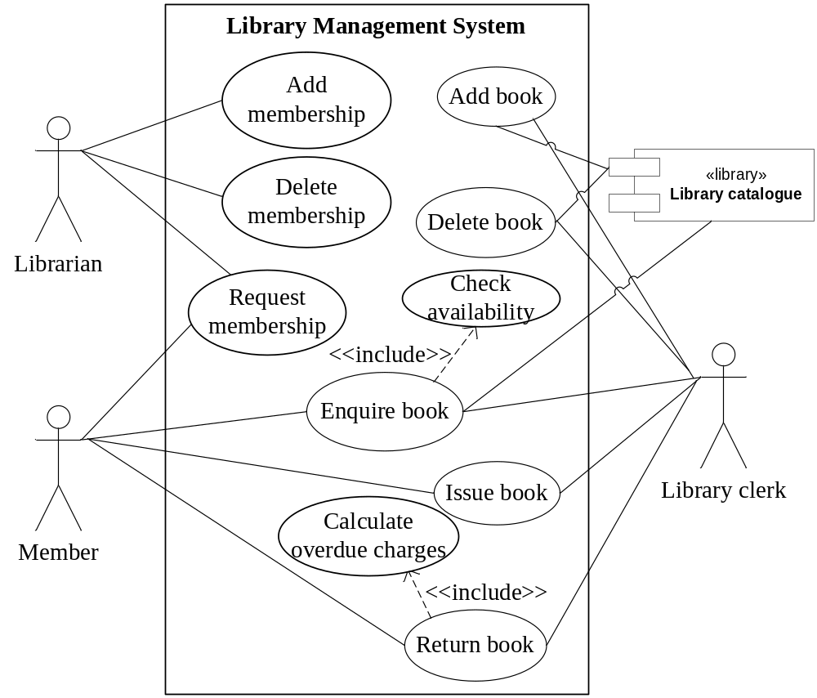
Use case for a library management system

Slide 9
Scenario 1: Request membership
System: Library management system
Use case name: Request membership | Use case number: UC-01
Participating actors: Initiated by the member and the librarian
Description: Request membership process allows a member to get membership from the librarian
Preconditions: Member should be a member of the organization
Post conditions: Membership form will be completed and verified by the librarian
Flow of events: 1. Member will request to take membership from the librarian 2. Librarian will provide the membership form 3. Member will complete the membership form and submit it to the librarian
Nonfunctional requirements: An understandable membership form should be designed
Reference documents: Member should be given a departmental membership manual

Slide 10
Scenario 2: Add membership
System: Library management system
Use case name: Add membership | Use case number: UC-02
Participating actors: Initiated by the librarian
Description: Librarian adds the member to the library management system
Preconditions: Membership form must be completed
Post conditions: Membership ID will be generated
Flow of events: 1. Librarian will submit the form in the system 2. System will generate the membership ID
Nonfunctional requirements: Membership ID should be unique for each member
Reference documents: Details of membership documents

Slide 11
Scenario 3: Delete membership
System: Library management system
Use case name: Delete membership | Use case number: UC-03
Participating actors: Initiated by the librarian
Description: Membership of a member will be deleted from the library system
Preconditions: There should not be any due books or fee
Post conditions: The membership ID will be deleted from the library
Flow of events: 1. Member will request the librarian to withdraw the membership 2. The librarian will check for any due of books or fees 3. Membership ID will be deleted from the library
Nonfunctional requirements: There should not be any dues of deleted ID
Reference documents: Librarian keeps record of deleted membership

Slide 12
Scenario 4: Enquiry book
System: Library management system
Use case name: Enquiry book | Use case number: UC-04
Participating actors: Initiated by the member
Description: Member will enquire for a book from the library clerk
Preconditions: Member should be a registered member of the library
Post conditions: Library clerk will check the availability of the book from the library database
Flow of events: 1. Member will enquire for a book 2. Library clerk checks the availability from the library database 3. Library clerk acknowledges the member Sub-flow: 1. Check the availability of book in the system.
Nonfunctional requirements: Efficient searching of books from the library database
Reference documents: List of books

Slide 13
Scenario 5: Issue book
System: Library management system
Use case name: Issue books | Use case number: UC-05
Participating actors: Initiated by the member and the library clerk
Description: Member will request to issue books from the library clerk
Preconditions: Member should be a registered member of the library
Post conditions: Library clerk will issue the available book
Flow of events: 1. Member will request the book 2. Library clerk provides book if it is available in the library database 3. Library clerk updates the system according to member ID of the member
Nonfunctional requirements: Restricted number of books should be issued to the member
Reference documents: Issue process and guidelines

Slide 14
Scenario 6: Return Book
System: Library management system
Use case name: Return books | Use case number: UC-06
Participating actors: Initiated by the member and the Library clerk
Description: Member will return books
Preconditions: Return date should be within the specified time
Post conditions: Library clerk returns books
Flow of events: 1. Member will return the book 2. Library clerk checks the system for the return date 3. Library clerk updates the system and applies overdue charges, if any Sub flow: 1. Calculate the overdue charges
Nonfunctional requirements: Return records should be maintained
Reference documents: Return procedure and guidelines for overdue charges

Slide 15
Scenario 7: Add book
System: Library management system
Use case name: Add book | Use case number: UC-07
Participating actors: Library clerk
Description: Library clerk will add books in the library database
Preconditions: Books should have a unique identification number
Post conditions: List of added books
Flow of events: 1. Library clerk adds the books 2. Library clerk checks the system for the quantity of books 3. Library clerk updates the system
Nonfunctional requirements: There should be a unique number for each book
Reference documents: Purchased book records

Slide 16
Scenario 8: Delete book
System: Library management system
Use case name: Delete book | Use case number: UC-08
Participating actors: Library clerk
Description: Library clerk will delete books from the library database
Preconditions: Permission should be given by the librarian
Post conditions: Deleted books in a particular category
Flow of events: 1. Library clerk deletes the book 2. Checks the system for the quantity of books 3. Updates the system
Nonfunctional requirements: Book ID should be deleted
Reference documents: Deleted records

Slide 17
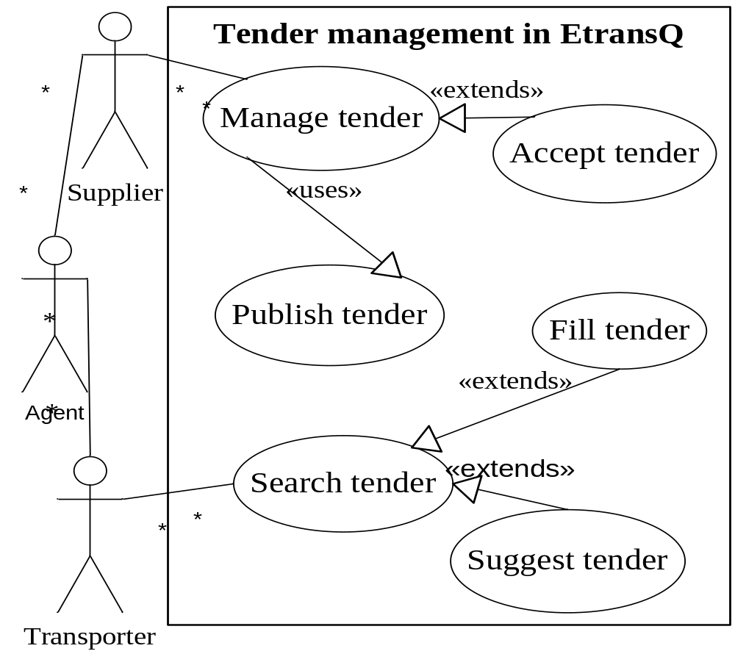
Use case for tender management in EtransQ system

Slide 18
Mainline sequence of the use case scenario
System: EtransQ
Use case name: Tender management | Use case number: UC-001
Participating actors: Supplier, agent, and transporter
Description: Tender management feature allows suppliers to post tenders. With this feature, transporters and agents can sort and search tenders with a single click. Once a tender is published, its date can be altered.
Preconditions: The user posting the tender should be a supplier.
Post conditions: 1. Notifications are generated for all his associates. 2. Supplier will get an email notification.
Flow of events: 1. Supplier requests to upload the tender. 2. After filling the form, the transporter has to upload a file in “pdf” format. 3. Once uploaded, the tender will be published on the specified date. Sub-flow: 1.Search tender. 2. Publish tender. 3. Activate/deactivate tender.
Nonfunctional requirements: There should be the best deal available in the market in case of a large shipment or have good relations with actors for a prolonged time
Reference documents: Tendering manual

Slide 19
USE CASE RELATIONSHIP
Sometimes use cases are refined into smaller use cases or use cases exchange information to each other.
There exist some relationships between use cases.
The goal is to reduce the complexities in the use case models.
There are four types of relations observed between use cases:
  includes,
  communicates,
  extends, and
  generalizes.

Slide 20
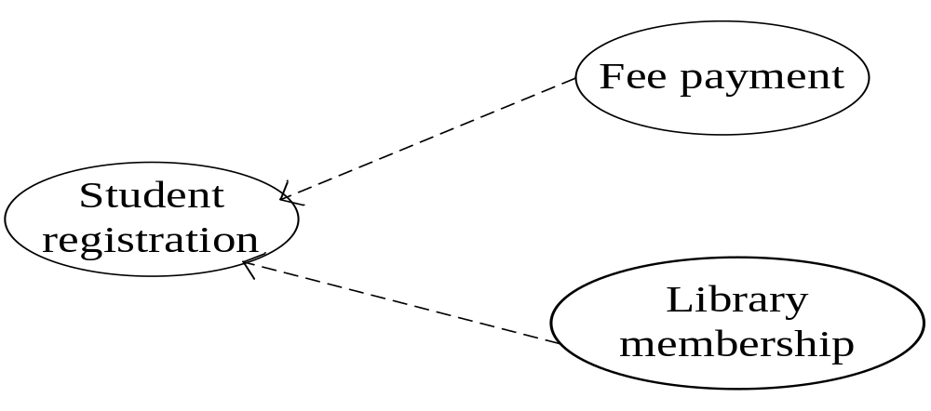
USE CASE RELATIONSHIP
INCLUDES
There may exist commonalities in use cases.
A use case may contain the behavior common to several use cases.
Use case is included in other use cases.

Slide 21
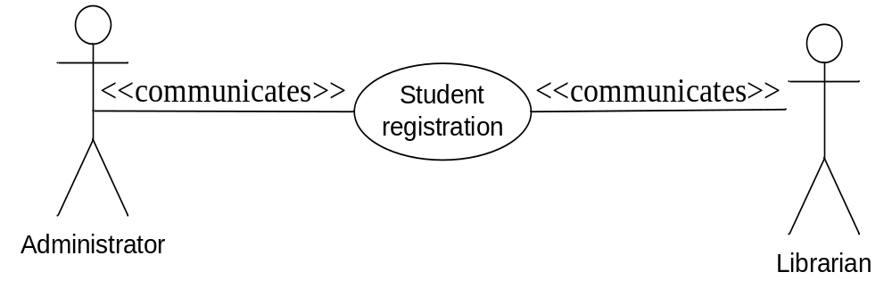
USE CASE RELATIONSHIP
COMMUNICATES
The communication relationship is used to exchange information between actors and use cases.
The communication relationship is shown by drawing a line between use cases and actors.

Slide 22
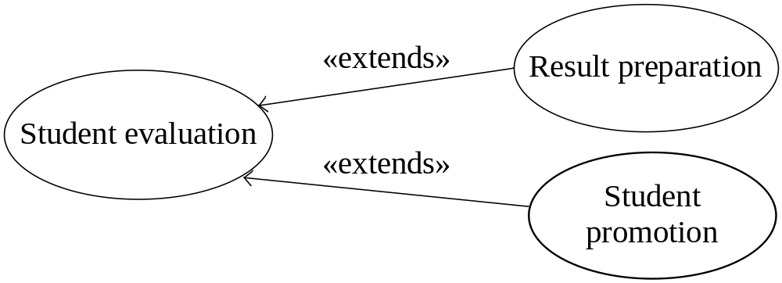
USE CASE RELATIONSHIP
EXTENDS
An extend relationship indicates that one use case (the extending use case) adds extra functionality to another use case (the base use case) when a specified condition is satisfied.
Extend relationship is used to extend a use case by adding events in it.
The extend use case may include the behavior of extending use case. For example, student evaluation extends to result preparation and student promotion.

Slide 23
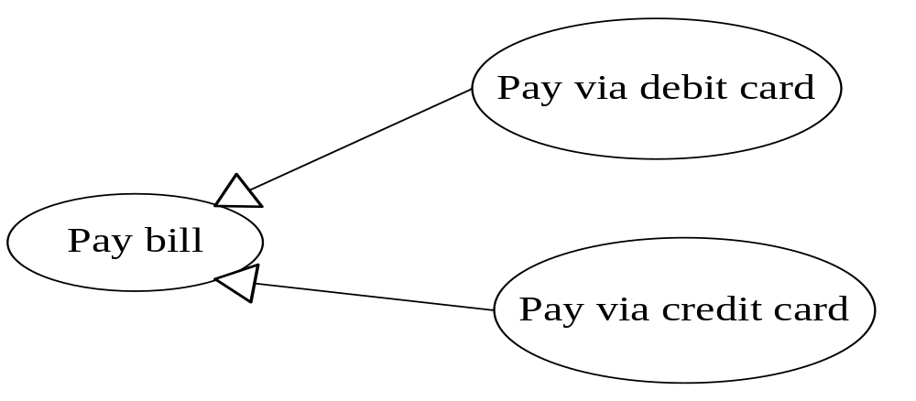
USE CASE RELATIONSHIP
GENERALIZES
It is used to specialize another use case or actor by adding or removing its behavior.
The child use case or actor inherits the behavior of its parent use case or actor.

Slide 24
CLASS DIAGRAM
The class diagram describes the structural description of the system.
Class diagram is prepared by establishing relationships among classes.
Class relationships are made using aggregation, generalization, association and dependency relationships.
During designing of class diagram, object oriented design principles are applied to design an optimized class diagram.
Class diagram can directly be implemented into the object oriented programming language.

Slide 25
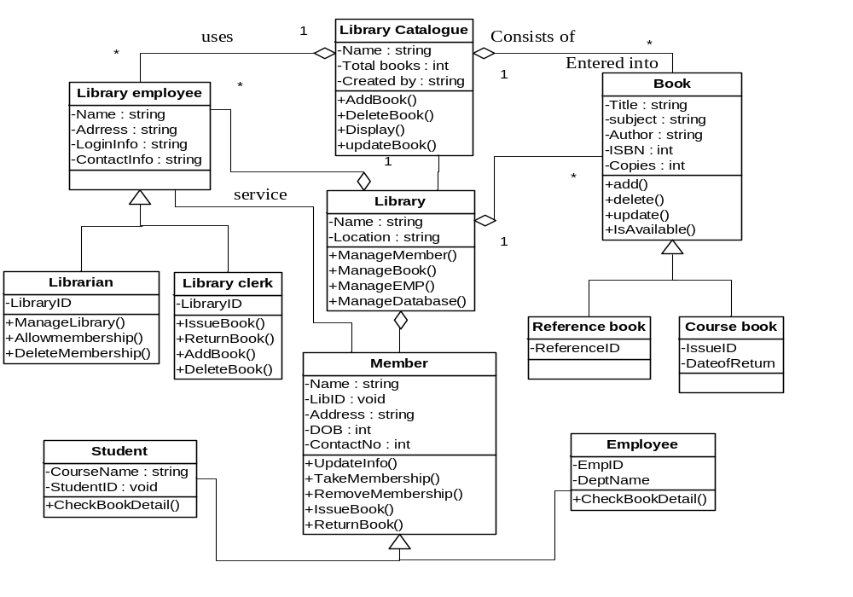
Class diagram for a library management system

Slide 26
OBJECT DIAGRAM
Object diagrams are the instances of class diagrams.
From an implementation point of view, object diagrams are dependent upon class diagrams.
Object instances are created, destroyed, and modified during the execution of the system.
Object diagrams also represent the structural view of a system but they are the snapshot of a system at a particular moment.
The data values are shown with the objects.
An object diagram is closer to the actual system behavior.

Slide 27
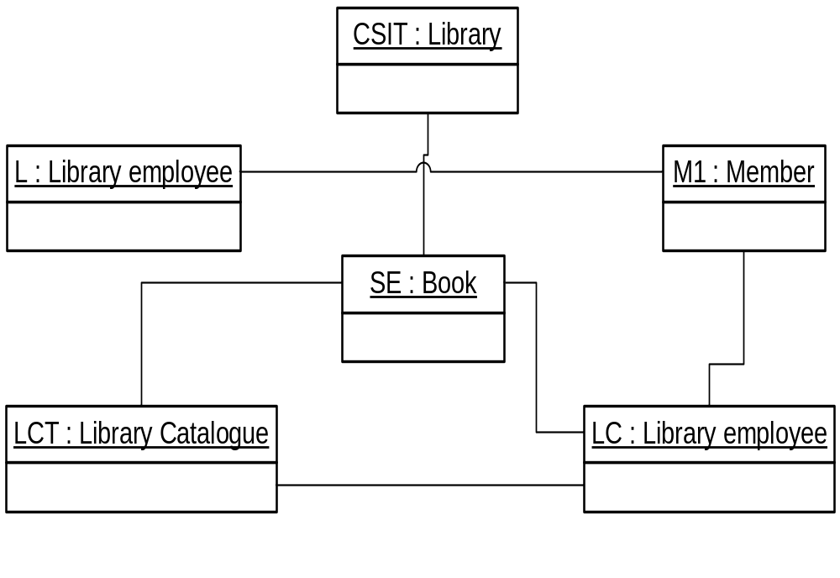
Object diagram for a library management system

Slide 28
INTERACTION DIAGRAM
Objects interact by passing messages along with their signatures.
Upon receiving a message, an object triggers the execution of a method and in turn sends a message to another object.
Such interaction of objects is represented pictorially through interaction diagrams.
The interaction diagram has two forms: sequence diagram and collaboration diagram.
Both diagrams represent the dynamic behavior of the system.

Slide 29
SEQUENCE DIAGRAM
A sequence diagram shows the interaction among objects by passing messages in a time- based sequence.
The diagrammatic representation of a sequence diagram has two dimensions: vertical dimension and horizontal dimension.
The vertical dimension has vertical dashed lines that participate in the interaction represent object’s lifeline.
The object’s lifeline states the existence of the object at a particular point of time.
The messages that they exchange are arranged in time sequence. Object names are written inside the box at the head of the vertical lines and these are underlined.
The vertical lines indicate timing that progresses downwards. The horizontal dimension represents different objects without any ordering.

Slide 30
SEQUENCE DIAGRAM
A vertical thin rectangle called activation symbol on lifeline shows the period during which an object is active.
During the activation period, an object performs an action either directly or through its subparts.
The action being performed by the object is labeled in text next to the activation symbol. Activation can be merged or split into parts.
Objects communicate through messages passed among them. A message is shown as a horizontal solid arrow from the lifeline of one object to the lifeline of another object.
When an object calls itself, then message arrow may start and finish on the same object’s lifeline.
The message arrow is labeled with the message name and its argument values.
Sometimes, messages are labeled with sequence number to show the sequence of the message in the overall interaction.

Slide 31
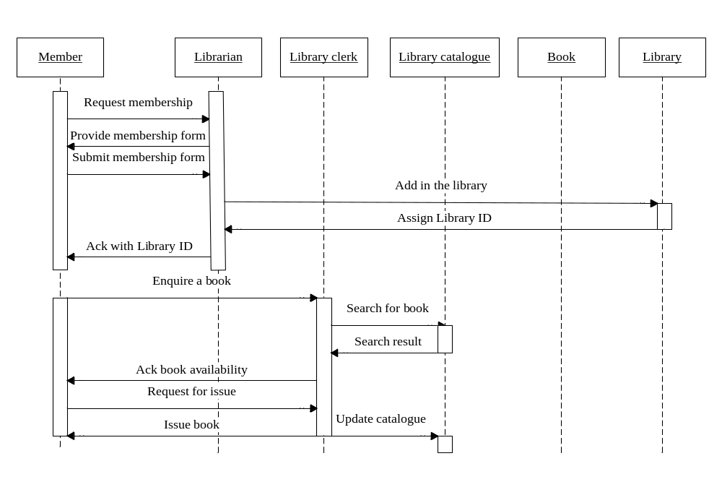
Sequence diagram for a library management system

Slide 32
COLLABORATION DIAGRAM
A collaboration diagram is also used to represent object interaction.
Objects are represented as and when they come in the system and numbered messages are sent from one object to another.
The number in the message is the sequence in the object interactions. Messages are shown along the association line with their directions of movement.
Collaboration diagram does not show time as a separate dimension, so the sequence of messages and the concurrent threads must be determined using sequence numbers.
The collaboration diagram shows the context in which interaction occurs among objects.

Slide 33
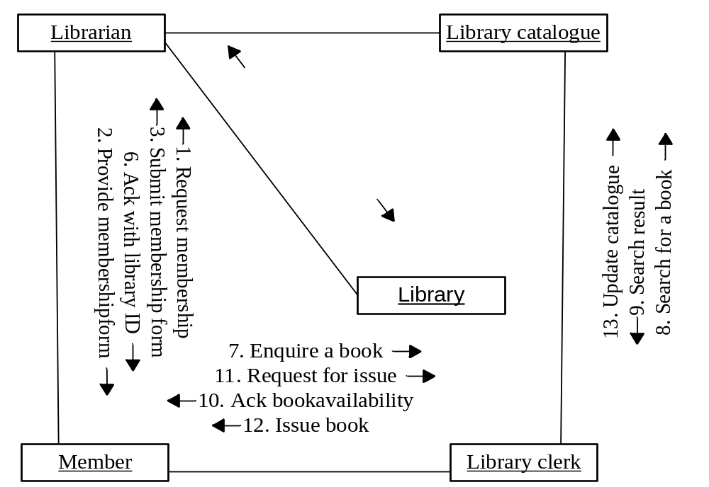
Collaboration diagram for a library management system

Slide 34
STATE CHART DIAGRAM
An object goes through various states to show the behavior of a system.
The state changes whenever an event occurs.
State chart diagrams consist of states and transitions.
A state represents a condition satisfied by the attributes of an object.
It is drawn as a rounded rectangle with its name inside it.
A small filled circle represents the initial states and a circle surrounding the small filled circle is indicated as final state.
A transition is represented by an arrow between one state to another state with the event name in it causing transition.

Slide 35
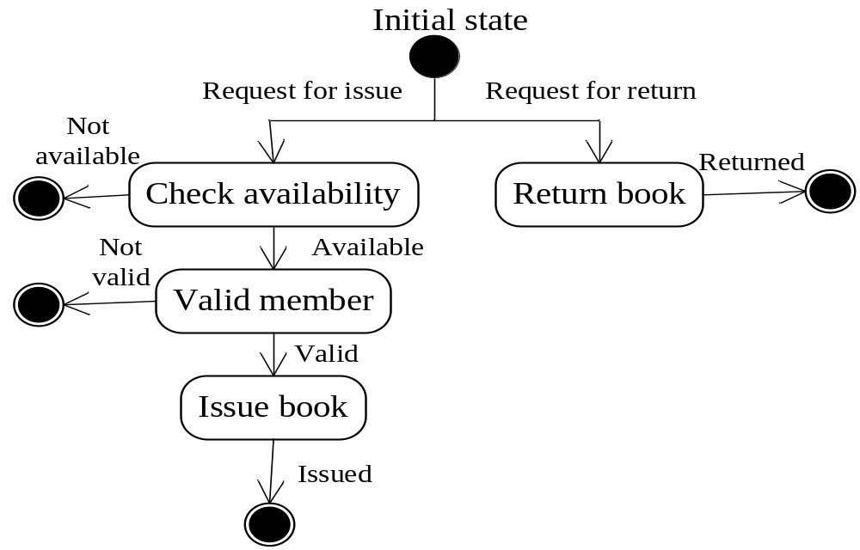
State chart diagram for a library management system

Slide 36
ACTIVITY DIAGRAM
An activity diagram also illustrates the dynamic view of a system.
The activity diagram is basically a kind of state chart diagram that represents the procedural flow of controls from one activity to another.
An activity can be described as an operation of the system.
Action states are shown as a rounded rectangle. The completion of an action state is shown by an arrow.
The branching conditions are shown with a small diamond box that represents the alternative paths.
The outgoing arrows are labeled with a condition or guard expression.
The outgoing arrows represent the set of all possible outcomes.

Slide 37
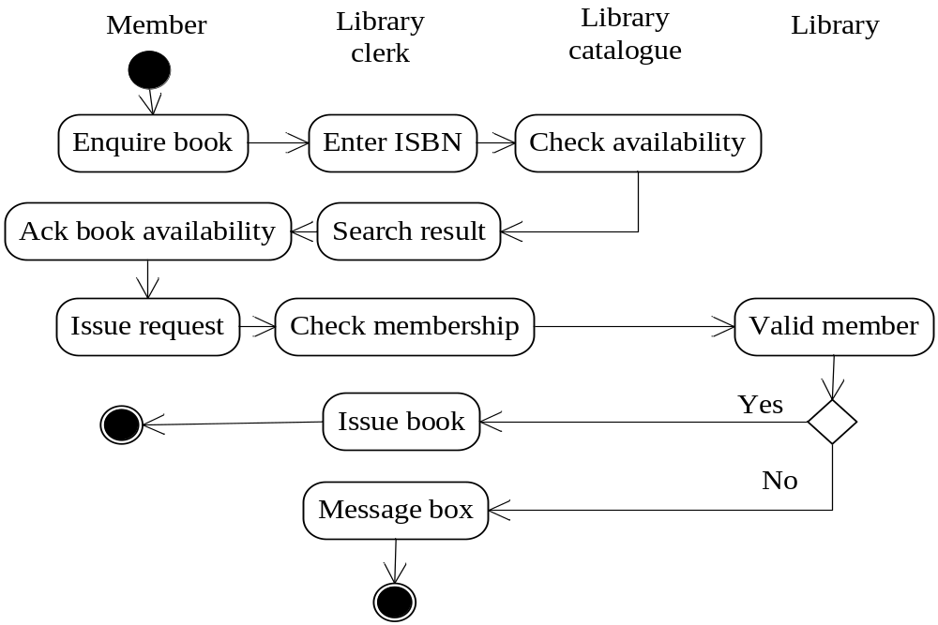
Activity diagram for a library management system

Slide 38
COMPONENT DIAGRAM
Component diagrams represents the implementation view of the software in a system.
A component diagram is made by connecting components through dependency relationships.
Components are the different parts of a system. They can be source code components, executable components, binary components, business components, etc.
There are five components in this system and these are book management, member management, library EMP management, library catalog, and library main system.

Slide 39
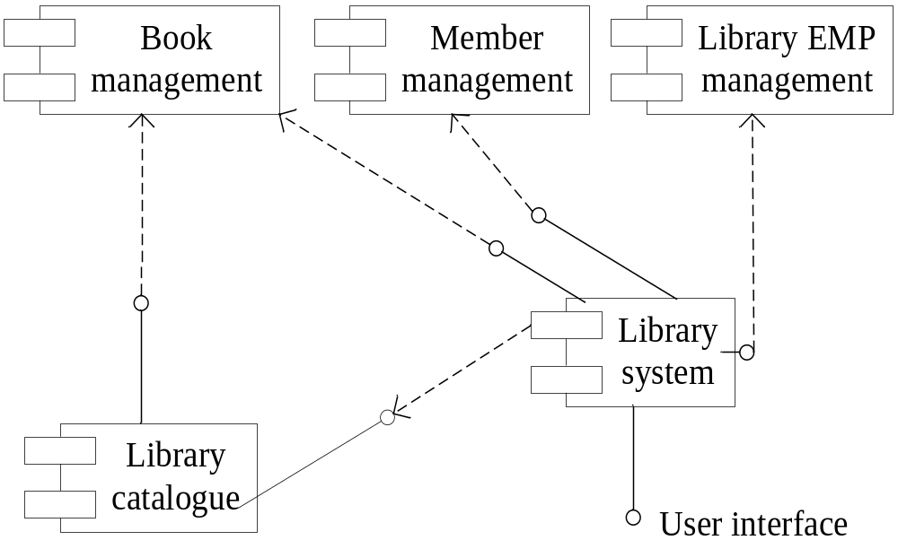
Component diagram for a library management system

Slide 40
DEPLOYMENT DIAGRAM
A deployment diagram shows the configuration of runtime processing elements at the customer site.
It is a graph of nodes connected by communication associations.
A deployment diagram is a kind of graph made up of components connected by communication associations.
Nodes may contain component instances; this indicates that the component lives or runs on the node.
There are three nodes used in this system and these are client desktop, application server, and database server.

Slide 41
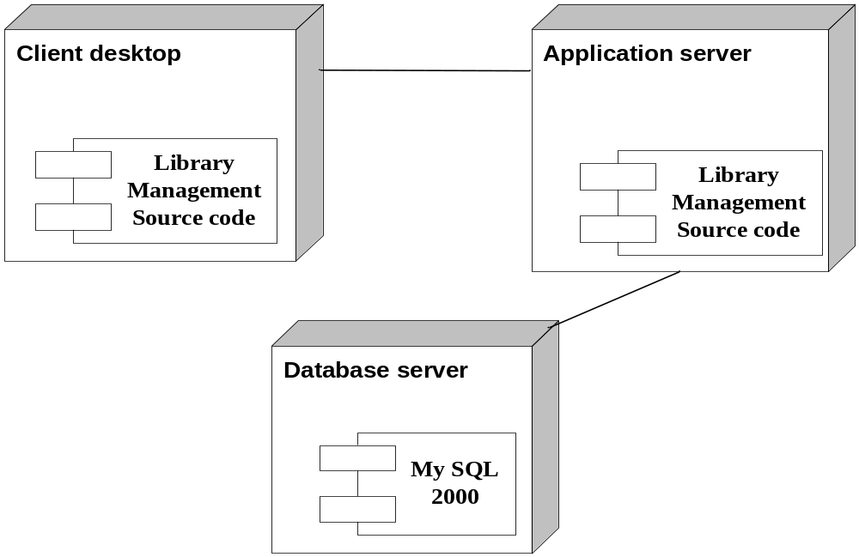
Deployment diagram for library management system

